Slide 1
“On the way with Python”

Slide 2
Start with Python
Lecture
01

Slide 3

Purpose of the Class

Slide 4

What is Python?

Slide 5
What is Python?
Python is an interpreted, object-oriented, high-level, and general-purpose programming language. Python is known for its simple syntax, readability, and wide range of applications.

Slide 6
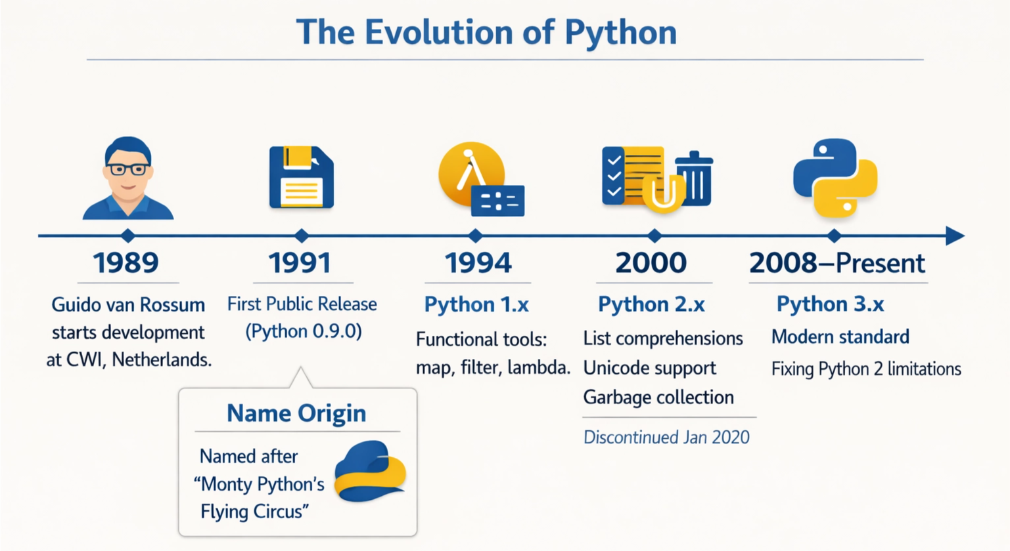
Evolution of Python

Slide 7
Why Python?

Slide 8
Why Python?
Simple and Easy to Learn
Versatility
Free & Open Sources
Portable: Works on Linux/Windows/Mac
Strong Community
Career Opportunities

Slide 9

Importance of Python

Slide 10
Career Opportunities of Python
Web Development
Game Development
Data Science & Analytics
Machine Learning & AI
Automation
IOT & Robotic
Cybersecurity
Scientific Computing
Cloud Computing
Research & Development
Software Development

Slide 11
“Sector-wise Topics Specification”

Slide 12
Python for Web Development
Django
Flask
FastAPI

Slide 13
Python for Game Development
Pygame
Panda3D
Godot

Slide 14
Python for Desktop Application
PyQt
Tkinter
Kivy (Cross-Platform)
Electron

Slide 15
Python for Data Science & Analytics
Pandas (Data Manipulation)
NumPy (Numerical Computing)
Matplotlib/Seaborn (Visualization)
SciPy (Scientific Computing)

Slide 16
Python for AI & ML
Scikit-learn
TensorFlow
PyTorch
Keras
OpenCV

Slide 17
Python for IoT & Robotics
GPIO Zero (Raspberry Pi)
MicroPython (Embedded Systems)
ROS (Robot Operating System)
OpenCV
TensorFlow Lite

Slide 18
AFTER THAAAAT…
I want to become WHAT???🤔 Decision PENDING!!!😵‍💫

Slide 19
“Let’s Know about Python😎”

Slide 20
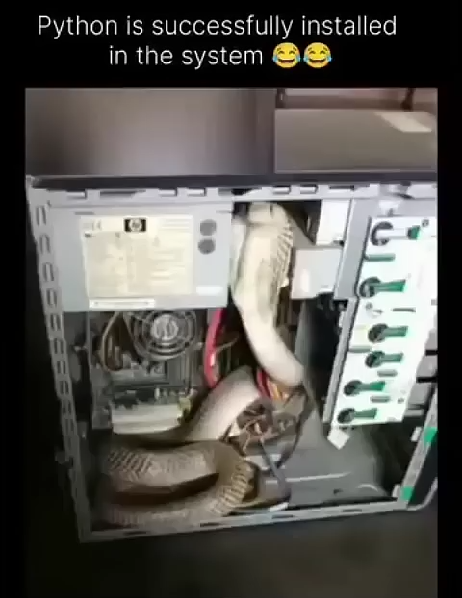

Slide 21

Now I’m a Python Programmer😎
Backend Developer
Python Developer
Machine Learning Engineer
AI Engineer
Data Analyst
Automation Engineer

Slide 22

Uses of Python on Different Application!

Slide 23






Web Development

Slide 24
Game Development
The Sims
Civilization IV
Eve Online
BattleField 2
Frets on Fire

Slide 25
Machine Learning & AI
Google – Search, Image Recognition
OpenAI - ChatGPT
Netflix - Recommendation
Apple – Face ID, Siri
Amazon – Alexa, Recommendation
LinkedIn – Job Recommendation
Tesla - Autopilot
Alibaba – Alibaba AI
Microsoft – Azure, Cortana

Slide 26
Data Science & Analytics
Netflix
Airbnb
Spotify
Uber
Google
Amazon
Facebook
Dropbox
NASA

Slide 27
““Thanks All””

